Slide 1

Department of CSE-AI & ML (CSM)
Team:BATCH7
21BQ1A42I1, 21BQ1A42F3,
21BQ1A42D6, 21BQ1A42I4
Project Title:
Online Voting System Using Machine Learning and Blockchain
TEAM MEMBERS:
21BQ1A42I1 Vuha Chandrika Ippala
21BQ1A42F3 Rithika Edara
21BQ1A42D6 Mahesh Palakaluri
21BQ1A42I4 Chaitanya Yaragalla
Under the Guidance of:
(Project Guide) HOD-CSM,
Dr. K. Gnanendra Dr.K.Suresh Babu

Slide 2
Department of CSE-AI & ML (CSM)
Team:BATCH7
21BQ1A42I1, 21BQ1A42F3,
21BQ1A42D6, 21BQ1A42I4
Abstract:
The Online Voting System Using Blockchain with Ethereum and Machine Learning is designed to provide a secure, transparent, and decentralized solution for modern elections. This system leverages the power of blockchain technology, specifically Ethereum with Ganache, to ensure the immutability and integrity of votes. By utilizing face recognition for voter authentication, the system further enhances security, preventing identity fraud and ensuring that only eligible voters can participate. Additionally, the integration of machine learning algorithms, including Decision Trees, Random Forests, and Logistic Regression, allows the system to predict future election trends based on historical data, providing valuable insights into the likely outcomes of elections.
The system features several key components: Voter Registration & Authentication, where voters are registered by the admin and verified using face recognition before voting; Election & Candidate Management, which allows the admin to create new elections and add candidates, with all data securely stored on the blockchain for transparency; Secure & Transparent Voting Process, where votes are digitally cast and recorded on the Ethereum blockchain to prevent manipulation; and Election Results & Voter Insights, where results are displayed securely after voting and provide real-time insights into the election process. The system also includes a feature for Future Election Prediction, where machine learning models predict outcomes based on multiple factors such as party, age, education, and other relevant parameters.
This blockchain-based online voting system ensures that the election process is fair, transparent, and secure, and that voter data is protected. The integration of machine learning provides valuable predictions and insights into voting trends, helping stakeholders make informed decisions. By employing advanced technologies such as blockchain and machine learning, the system aims to enhance trust in digital voting and promote democratic practices globally, ensuring a more reliable, efficient, and secure election process.

Slide 3
Department of CSE-AI & ML (CSM)
Team:BATCH7
21BQ1A42I1, 21BQ1A42F3,
21BQ1A42D6, 21BQ1A42I4
The "Online Voting System Using Blockchain with Ethereum and Machine Learning" provides a comprehensive solution to modernize and secure the electoral process. By utilizing Ethereum blockchain, the system ensures that every vote cast is immutable, transparent, and tamper-proof. Voter authentication is made secure through face recognition technology, preventing identity fraud and allowing only registered voters to participate.
The system leverages machine learning algorithms like Decision Tree, Random Forest, and Logistic Regression to predict future election outcomes based on historical data, helping provide insights into voting trends and potential election results. The secure voting process ensures that each vote is recorded on the blockchain, eliminating any risk of manipulation.
The proposed solution also ensures that the election process is transparent, as all votes are publicly verifiable on the blockchain. This system addresses the need for a more secure, efficient, and transparent voting process, ensuring trust in the digital voting system and enabling smoother, faster elections.
Functional Requirements :
Voter Registration and Authentication:
  Secure registration via face recognition.
  Verification of identity to prevent fraudulent voting.
  Customizable voter profiles with personal information.

Slide 4
Department of CSE-AI & ML (CSM)
Team:BATCH7
21BQ1A42I1, 21BQ1A42F3,
21BQ1A42D6, 21BQ1A42I4
Secure Voting Process
Voters cast votes digitally, which are securely recorded on the Ethereum blockchain.
Ensures immutability, transparency, and tamper-proof election results.
Prevents duplicate votes, ensuring fairness in the election process.
Election Result Prediction with Machine Learning
Machine learning algorithms (Decision Tree, Random Forest, Logistic Regression) predict election outcomes.
Predictive models use data such as party, demographics, criminal cases, education, and more.
Provides real-time insights into potential election results based on historical data.

Slide 5
Department of CSE-AI & ML (CSM)
Team:BATCH7
21BQ1A42I1, 21BQ1A42F3,
21BQ1A42D6, 21BQ1A42I4
Election Results Display
Results are displayed securely after voting ends.
The system offers an overview of voting trends and breakdowns.
Enables public transparency of election outcomes.
Offline Functionality
Record votes and verify identity offline.
Sync data to the blockchain and cloud once an internet connection is restored.
Ensures uninterrupted voting and authentication, even in areas with poor internet access.

Slide 6
Department of CSE-AI & ML (CSM)
Team:BATCH7
21BQ1A42I1, 21BQ1A42F3,
21BQ1A42D6, 21BQ1A42I4
Software Requirements:
Frontend Development
UI Design: Figma for designing the user interface.
Frontend Languages: HTML, CSS, JavaScript, Bootstrap for creating responsive, user-friendly web interfaces.
Backend Development
Programming Languages: Python for backend logic and Django for web framework.
Blockchain Integration: Solidity for smart contract development on Ethereum.
API Testing: Postman for testing REST APIs.
Machine Learning & Prediction
Machine Learning Algorithms: Decision Tree, Random Forest, Logistic Regression for election prediction.
Machine Learning Libraries: scikit-learn and TensorFlow for model training and prediction.
Authentication & Security
Face Recognition: Python Face Recognition Module for voter authentication.
Blockchain: Ethereum and Ganache for secure vote recording and transaction management.
Deployment & Hosting
Deployment: AWS EC2 for scalable cloud hosting.
Blockchain Deployment: Infura or Alchemy for Ethereum network integration.
Database
Database Management: SQLite for storing voter data and election-related information.

Slide 7
Department of CSE-AI & ML (CSM)
Team:BATCH7
21BQ1A42I1, 21BQ5A42F3,
21BQ1A42D6, 21BQ5A42I4
Hardware Requirements:
Operating System
OS: Windows/Linux for backend deployment or macOS for frontend development.
Hardware Specifications
RAM: Minimum of 4GB for smooth application operation.
Storage: 500GB HDD or SSD for data storage and blockchain management.
Graphic Card: Not mandatory, but 1GB of VRAM may be useful for development or machine learning model training.
Networking
Network Bandwidth: Minimum 5Mbps for smooth data fetching from the cloud and real-time updates.
Internet: Stable internet connection for uninterrupted communication with the blockchain and machine learning models.

Slide 8
Department of CSE-AI & ML (CSM)
Team:BATCH7
21BQ1A42I1, 21BQ1A42F3,
21BQ1A42D6, 21BQ1A42I4
Results:
The Online Voting System Using Blockchain with Ethereum and Machine Learning has been successfully implemented with a focus on ensuring a secure, transparent, and efficient election process. By leveraging Ethereum blockchain, the system guarantees immutable vote recording, ensuring transparency and preventing manipulation. Face recognition technology secures voter authentication, ensuring that only registered voters can cast their votes.
The system is capable of predicting election outcomes using machine learning algorithms like Decision Tree, Random Forest, and Logistic Regression, providing valuable insights into voting trends and election results. Votes are securely recorded on the blockchain, preventing tampering and ensuring the integrity of the election process.
Key features include real-time election result predictions, secure voting with immutable blockchain storage, and transparent, verifiable election outcomes. The system is designed to function smoothly across a variety of devices and platforms, ensuring accessibility for users in different environments.
Additionally, the integration of machine learning enables the system to continuously improve its predictions, providing valuable insights for future elections. Real-time feedback and election trends are displayed, enhancing the experience for administrators and voters alike.

Slide 9
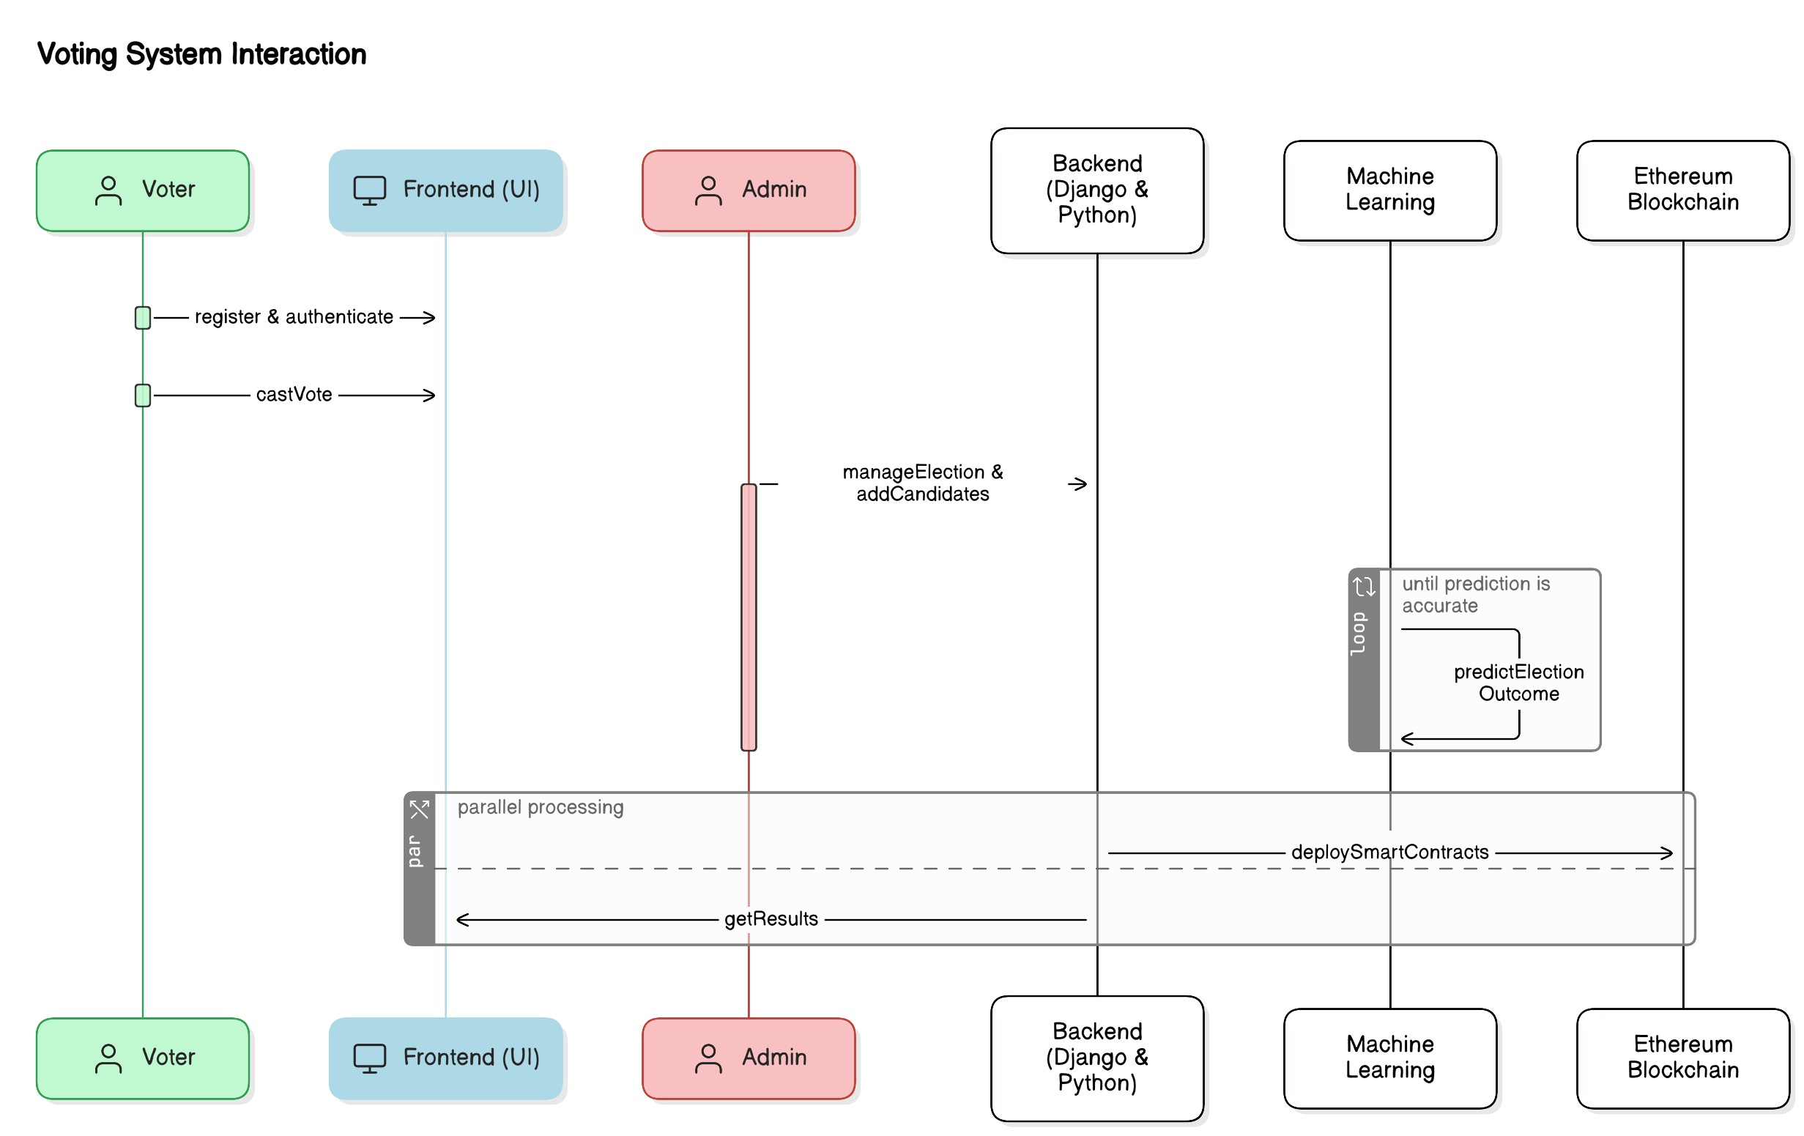
Department of CSE-AI & ML (CSM)
Team:BATCH7
21BQ1A42I1, 21BQ5A42F3,
21BQ1A42D6, 21BQ1A42I4
System Architecture

Slide 10
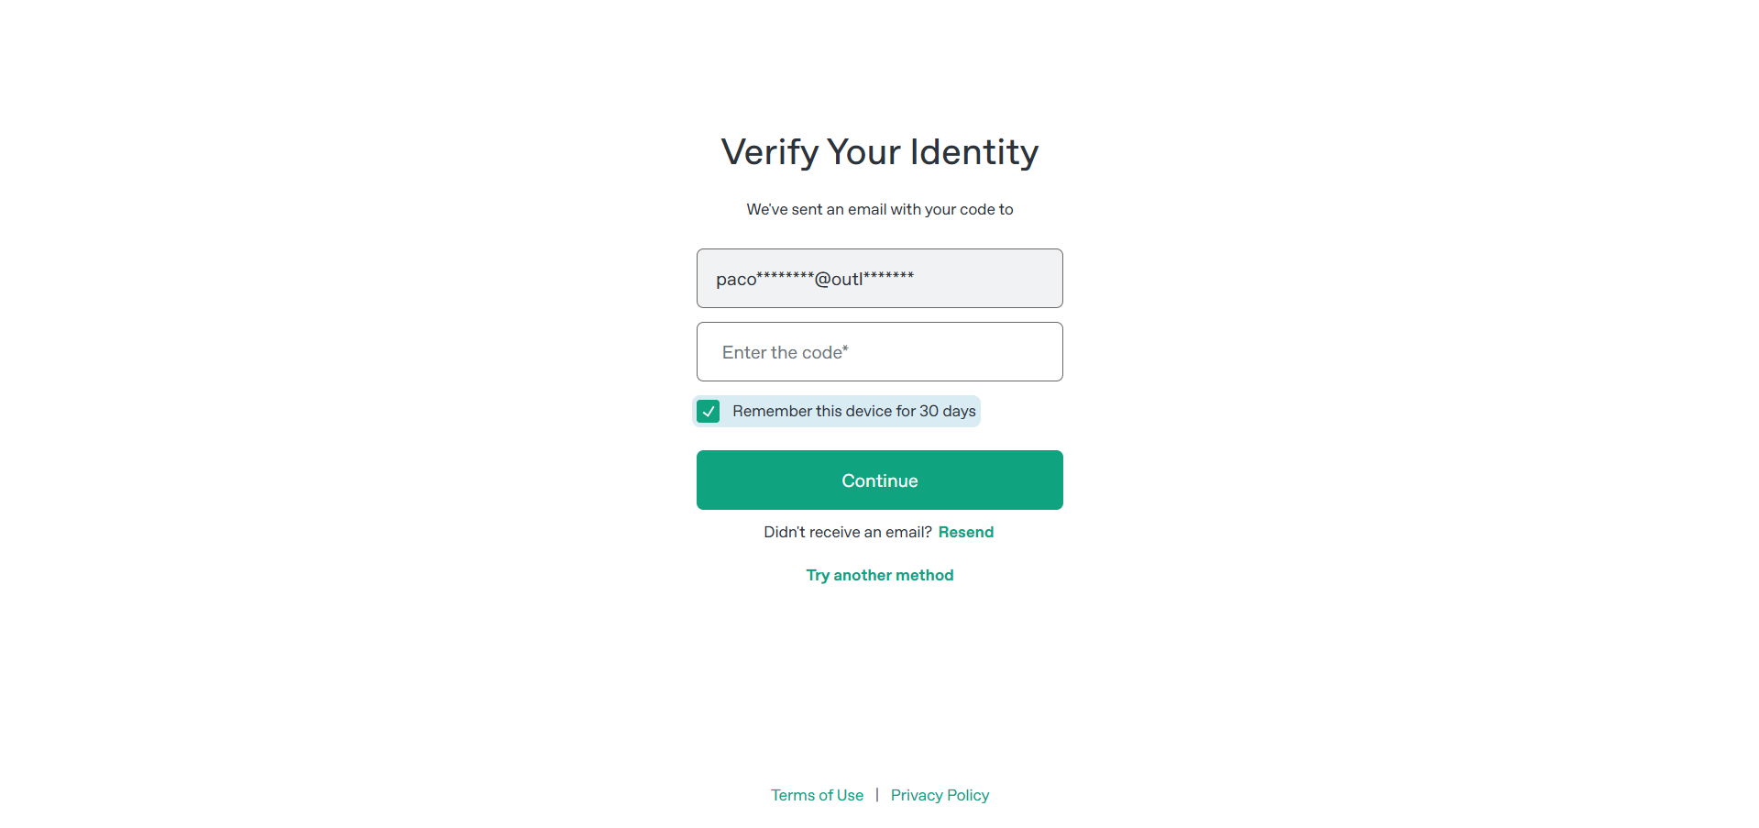
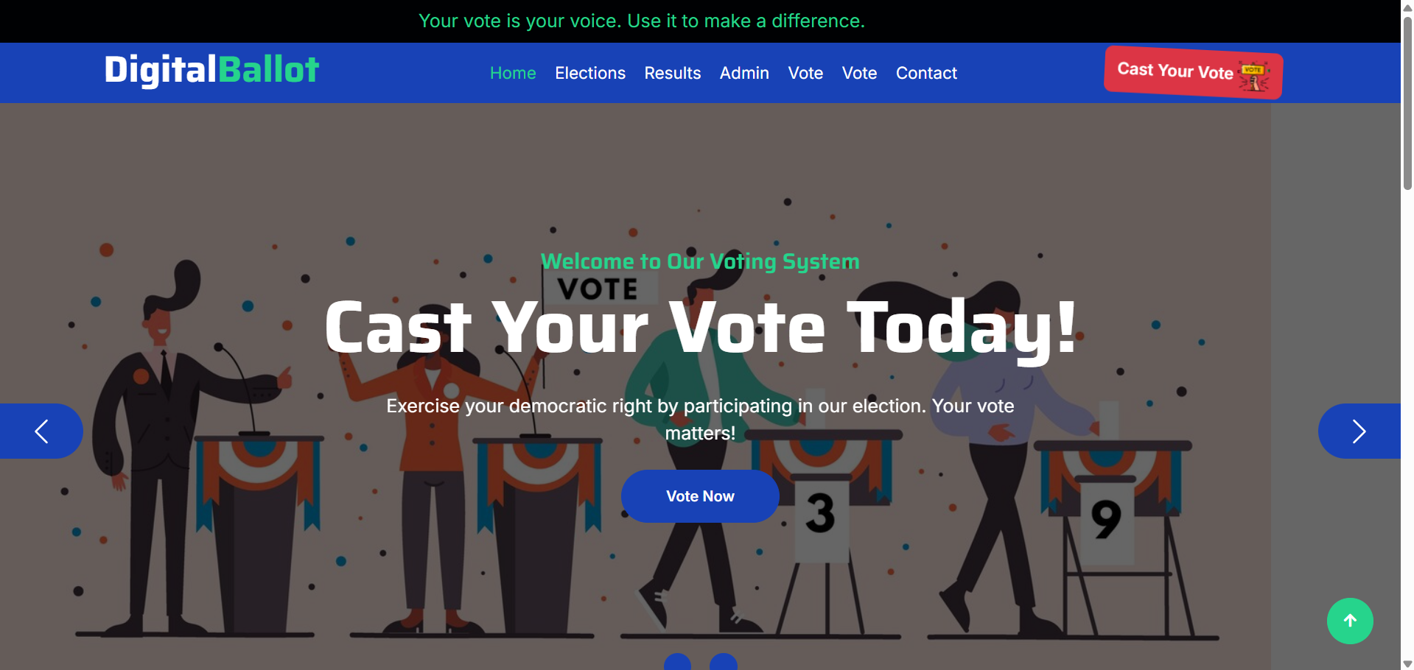
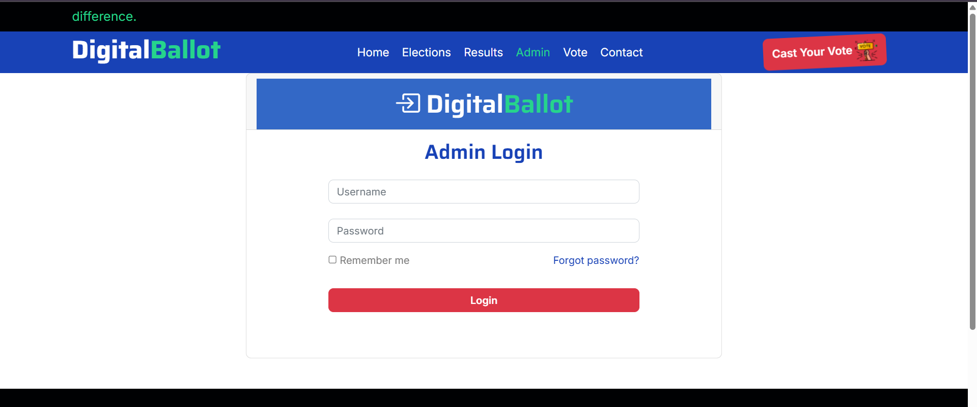
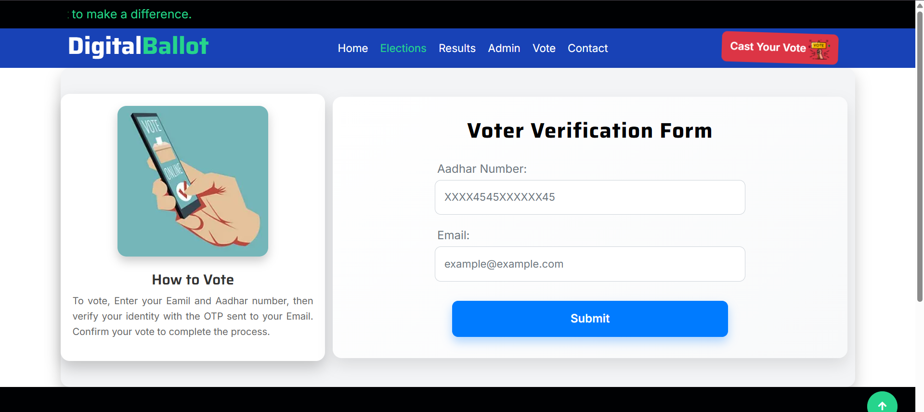
Department of CSE-AI & ML (CSM)
Team:BATCH7
21BQ1A42I1, 21BQ1A42F3,
21BQ1A42D6, 21BQ1A42I4
1. Voter Registration & Authentication
Admin registers voters with their face and voter ID.
Bulk data upload for easy voter registration.
Face recognition ensures secure voter authentication.

Slide 11
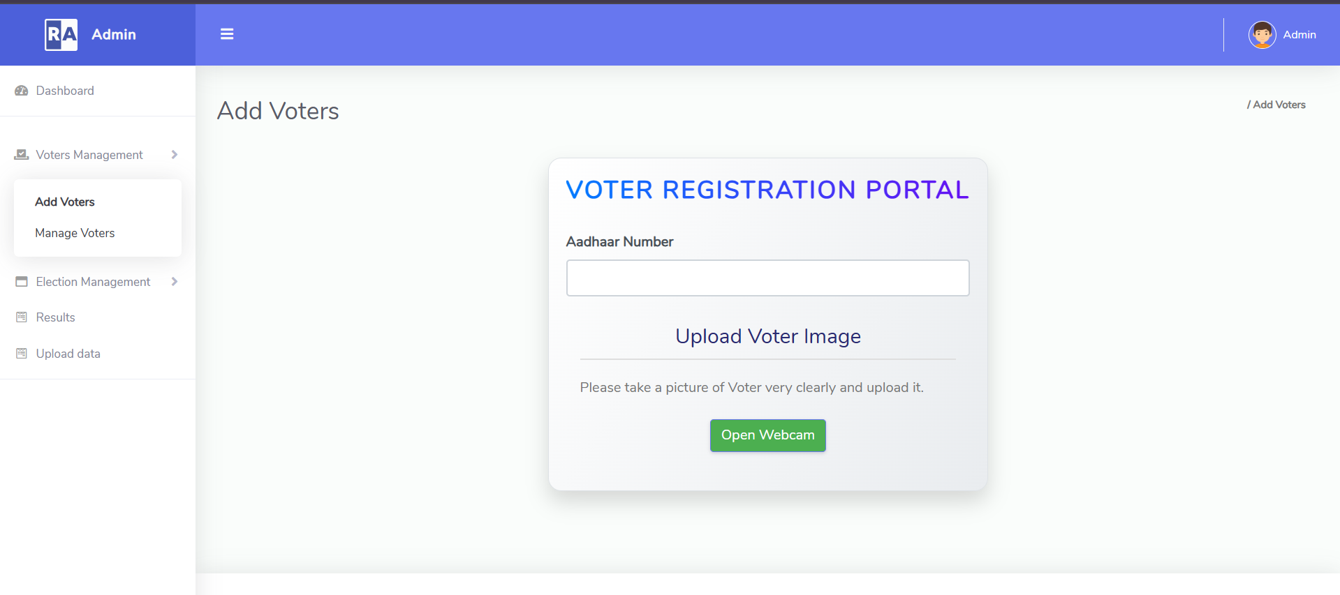
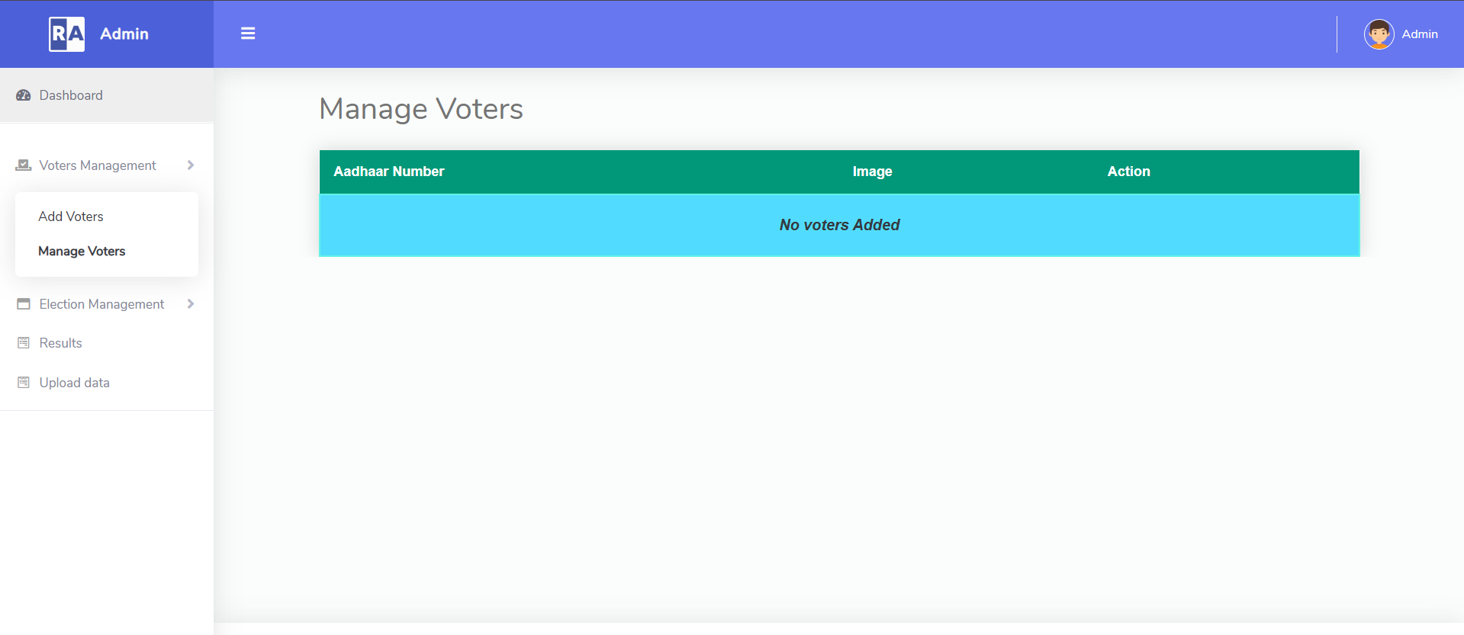
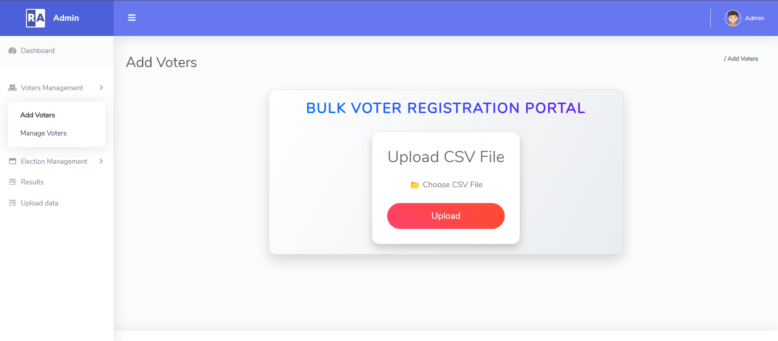
Department of CSE-AI & ML (CSM)
Team:BATCH7
21BQ1A42I1, 21BQ5A42F3,
21BQ1A42D6, 21BQ5A42I4
Election & Candidate Management
Admin can create elections and add candidates.
All election data is stored securely on the blockchain,
ensuring transparency.

Slide 12
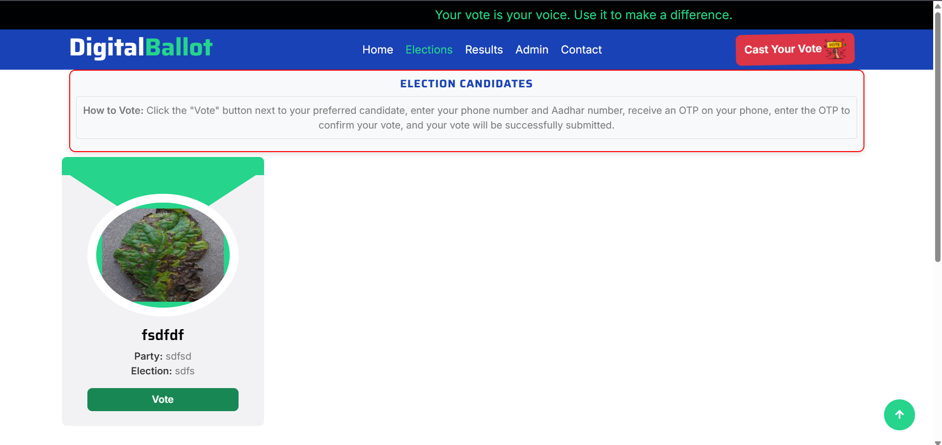
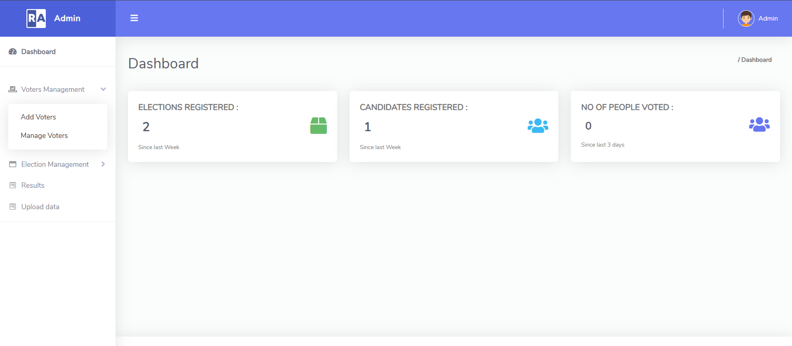
Department of CSE-AI & ML (CSM)
Team:BATCH7
21BQ1A42I1, 21BQ1A42F3,
21BQ1A42D6, 21BQ1A42I4
Secure & Transparent Voting Process
Voters cast votes digitally with immutable blockchain recording.
Only one vote per voter ensures fairness.

Slide 13
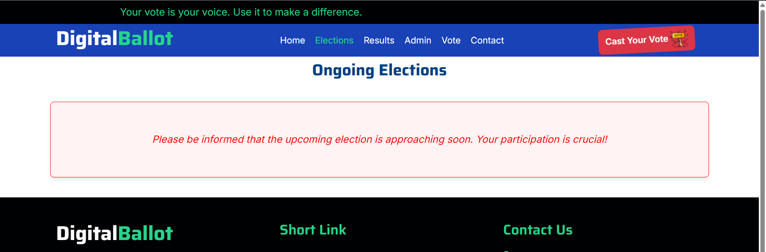
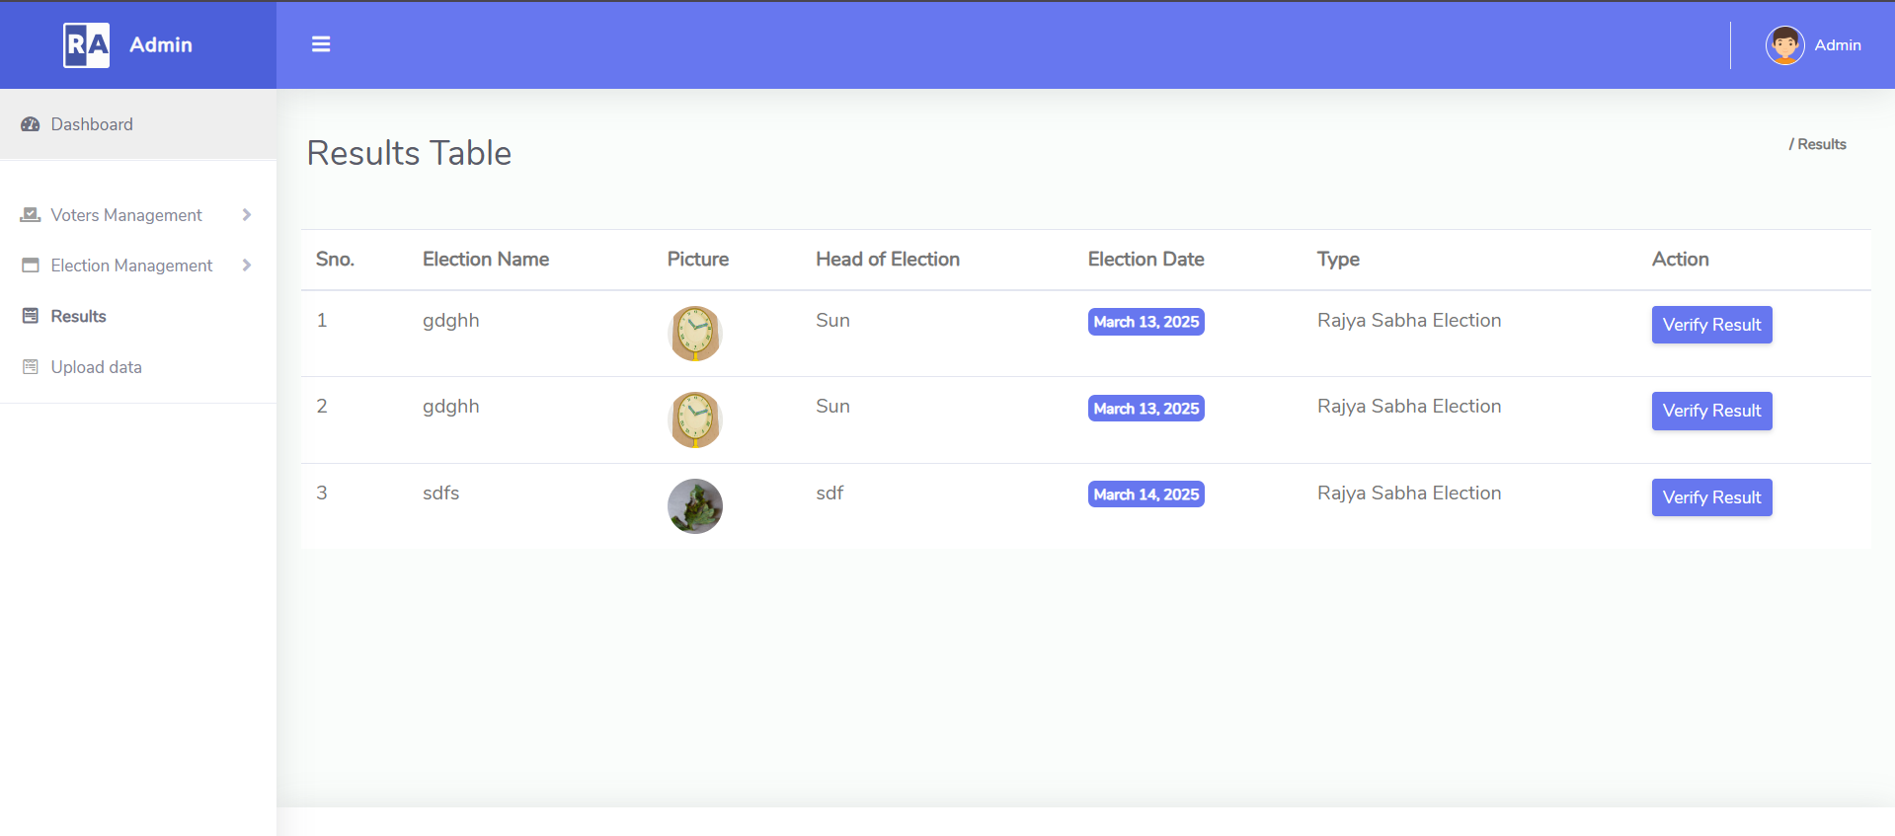
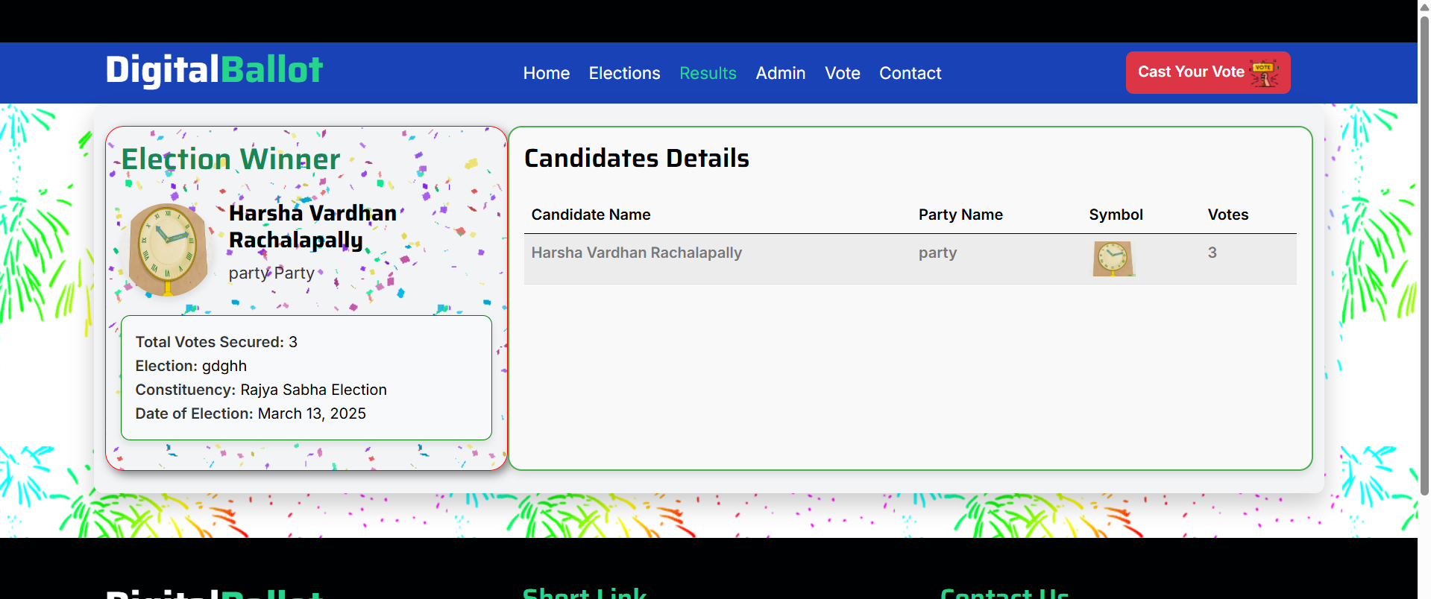
Department of CSE-AI & ML (CSM)
Team:BATCH7
21BQ1A42I1, 21BQ1A42F3,
21BQ1A42D6, 21BQ1A42I4
Election Results & Voter Insights
Election results are displayed securely the day after voting.
Provides insights and trends based on voting data.

Slide 14
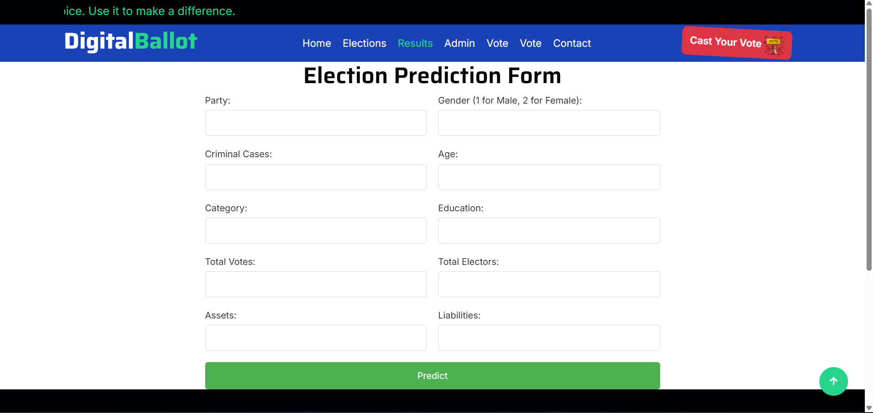
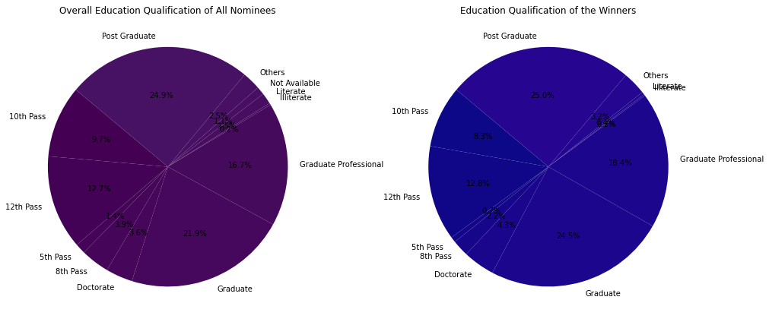
Department of CSE-AI & ML (CSM)
Team:BATCH7
21BQ1A42I1, 21BQ1A42F3,
21BQ1A42D6, 21BQ1A42I4
Future Election Prediction using Machine Learning
Predicts election outcomes with Decision Tree, Random Forest, and Logistic Regression algorithms.
Analyzes factors like party, gender, age, and more for accurate predictions.

Slide 15
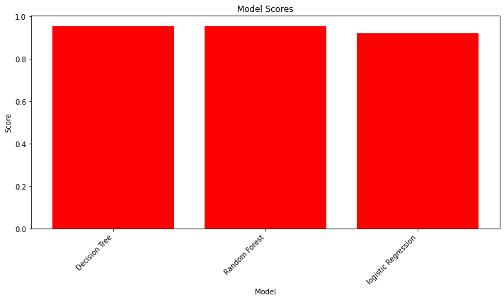
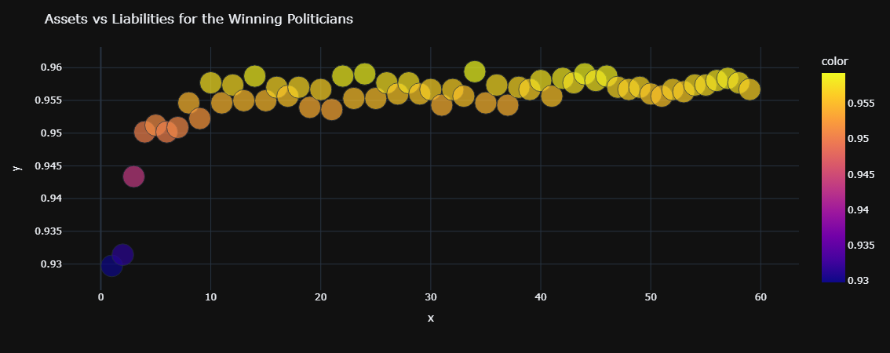
Department of CSE-AI & ML (CSM)
Team:BATCH7
21BQ1A42I1, 21BQ1A42F3,
21BQ1A42D6, 21BQ1A42I4

